Slide 1
Location Based Garbage Management System with IOT for Smart City
Project Proposal
Project ID : 17-100

Slide 2
G.S.B. Dabarera IT14005572
R.K.R. Ranaweera IT14005718
P.G.D.M Perera IT14008306
P.A.D.V.P Panangala IT14006326

Slide 3
Introduction
Proper waste management is a basic requirement in any kind of an environment.
With the implementation of smart cities such a system is essential, since the methods used by the current governments is not effective.
We’re proposing a system that will be
User Satisfactory
Environmentally Effective
Socially Acceptable
Economically Affordable

Slide 4

Research problem
There are just not enough garbage bins available
Overflowing garbage bins
Lots of environmental
issues
Research problem
Available workforce not utilized properly
No method to encourage and inform people

Slide 5
Research gap
Implementation | Feature 1 | Feature 2 | Feature 3
Smart Bin Implementation for Smart Cities (2015) | Fill levels via SMS | Real time bin level indicator | Real-time dashboard along with a time series graph
Cruisers: A Public Automotive Sensing Platform for Smart Cities (2016) | Garbage collecting trucks are used as host automobiles to accommodate sensors | 3G cellular communication network is used to wirelessly deliver sensed data | Java program to control sensor nodes
Notes:
Focusing on garbage level
Focusing on the location of the garbage truck

Slide 6
Research gap con ….
Implementation | Feature 1 | Feature 2 | Feature 3
IOT Based Smart Garbage alert system using Arduino UNO (2016) | Checking garbage bin levels and sending it to the municipal council | Use RFID Tag to confirm that cleaning is done | An Android application is developed and linked to a web server to send the alerts and remote monitor worker progress
Top–k Query based Dynamic Scheduling for IoT-enabled Smart City Waste Collection (2015) | City is divided into zones | Use of LCGT’s and HCGT’s | Uses cloud to collect data
Notes:
Focusing on Cleaner’s statistics
Focusing on garbage collection route

Slide 7
Methodology

Slide 8
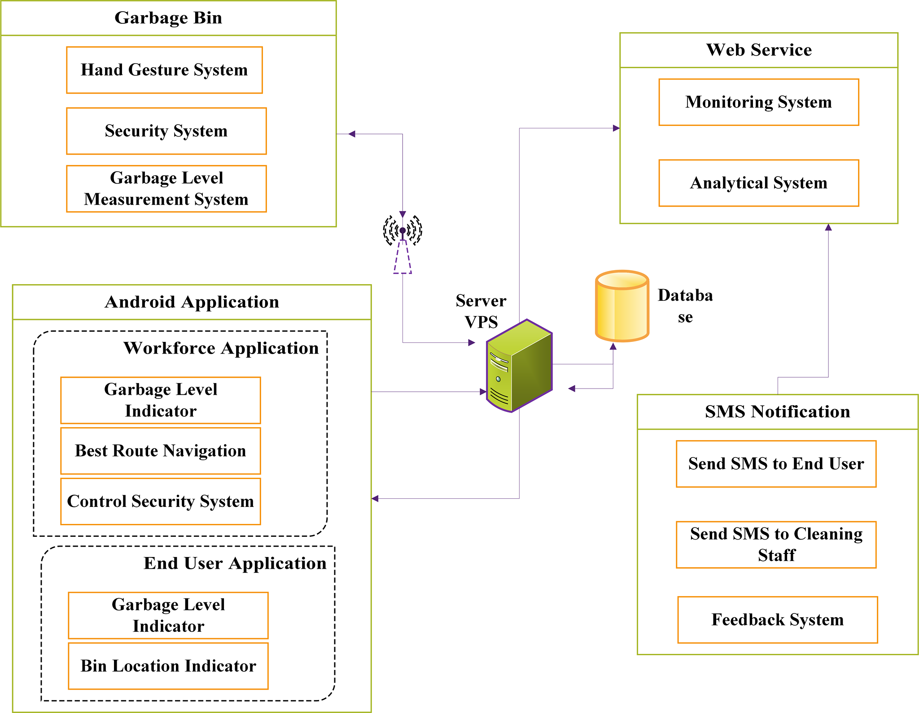
High-level Architecture

Slide 9
Setting up the Garbage Bin
All the Processes of the garbage bin are implemented on a Raspberry pi zero Development Board.
Setting up the garbage bin divided into three main sub-functions
Hand Gesture System
Measure the Real time Garbage level
Data Transfer
Bin lock mechanism
Security System

Slide 10
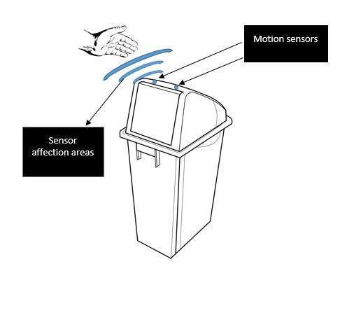
Hand Gesture System
Two motion sensors will be set in front of the bin.
These sensors will detect a simple hand movement.
When a motion detected, Servo motor will
Help to open and close the lid.

Slide 11
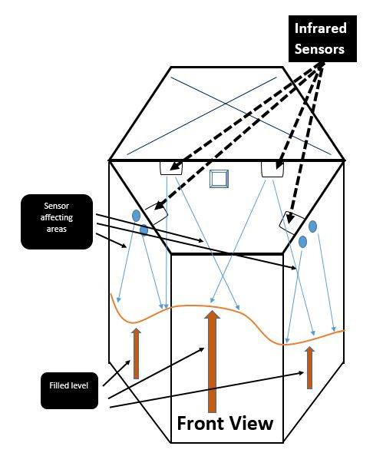
Measure the Garbage level
Using four infrared sensors an average
garbage level will be measured.
Garbage level will be sent through Wi-Fi using
ESP8266 Wi-Fi module.
When the garbage level reaches 100% the bin
lid will be automatically locked.

Slide 12
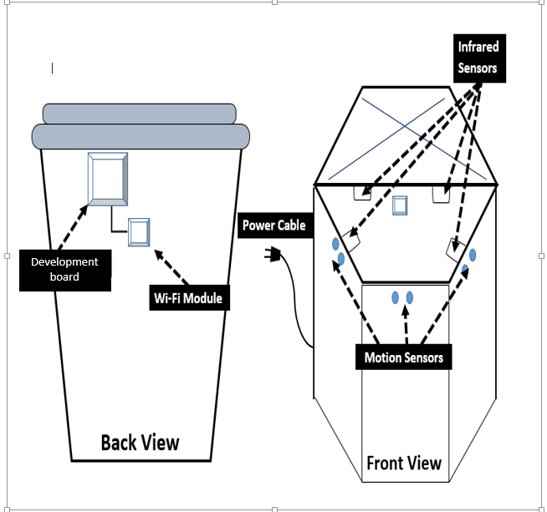
Security System
Since the proposed research is based
on location, Garbage bins will have a specific system to alert management of unauthorized movement.
While Workforce staff is cleaning bins,
they have a option to disable the sensors
until their job is finished

Slide 13
Web Server and Web Service Setup
Web Server Setup •
Setting up VPS•
Hosting website •
Installing and setting up Databases
Web Services •
Analytical system
Generate reports•
Monitoring system
Notes:
Building a Web API for the system

Slide 14
Server Service Provider
To select a service provider we considered
Google Cloud Console
Digital Ocean
AmazonAWS
Notes:
Google only 3 months
Digital ocean pricy
Free for a year with some limits

Slide 15
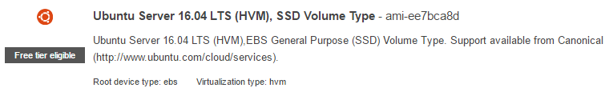
Server Specifications
OS - Ubuntu Server 16.04 LTS
RAM - 1 GB
Storage - 30GB SSD
Network Bandwidth – 15GB
CPU - 1 vCPUs, 2.5 GHz, Intel Xeon Family
Server location – Singapore
Service Provider - AmazonAWS
Notes:
Ping 50ms

Slide 16
Software to be Used
Software | Task
Puttygen | To create private key
Putty | SSH connect to the server
WinSCP | FTP client to transfer files
LAMP server | Package includes : Apache web server
 | : MySQL database
 | : PHP language

Slide 17

Purpose of the Website
Real time monitoring system
Display analyzed data
Manage Workforce
Get notifications on bin levels
Feedback and news update system for users
Notes:
Complaints and Compliments
Malfunctions, breakdowns, new system updates

Slide 18

Types of Users
Normal User
View real-time bin details
Give Feedback
Request bins on specific locations
Receives system news and updates
Management User
View real-time bin details
Track workforce progress
Add, remove and update bin details.
Get monthly, annual reports.
Manage normal users

Slide 19
Purpose of Webserver
Receive real-time bin updates and store them in the database
Feed Real-time data to monitoring system
Analyze stored bin levels and display them in the analytical system
Calculate routes for Workforce and Client applications
Manage bin security alerts
Enable/disable security system
Manage user feedback
Generate reports
Notes:
Graphs and charts
algorithm

Slide 20

Android Application Development
While in the development stage two separate applications will be developed for the workforce and the user. After the two applications have been developed, the two apps will be merged together to form one final application
Workforce Application
Real-time level and bin location
Route calculation
disabling/re-enabling security system

Slide 21
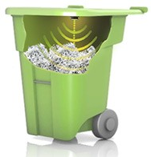
Real time levels & Bin location
The map shows all the bins that are placed throughout the city. The cleaner can access each bin to get all the specific information about the bin like real time level, history of fill levels, etc.

Slide 22
Route calculation
When a certain bin reaches 80% fill level the cleaner receives the best route calculated to the that bin from the base station.
This route is calculated taking into consideration some other bins that will be filled in a certain period of time in the future.
These extra bins will be added as waypoints into the route.

Slide 23
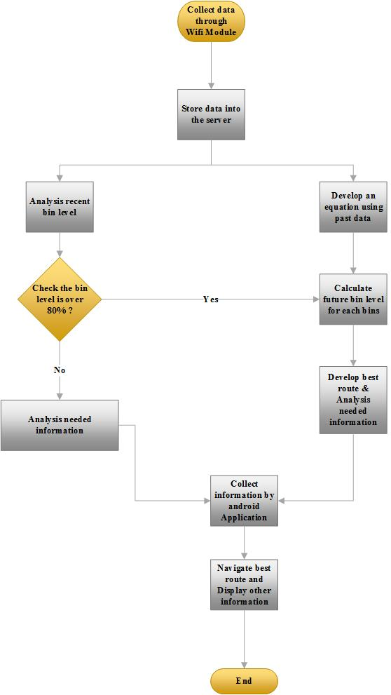
Route Calculation Flow Chart

Slide 24
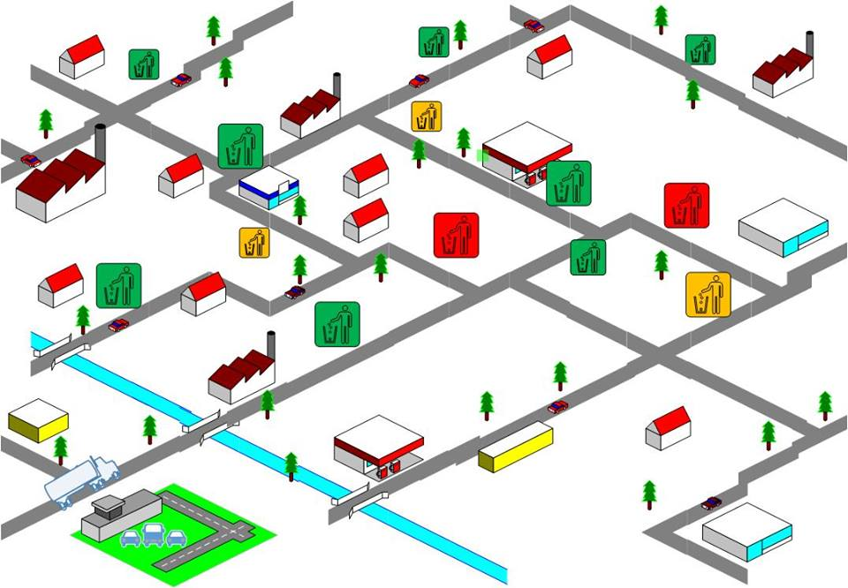
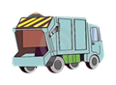
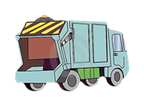
Workforce Route Navigation

Slide 25

Disabling and Enabling Security System
As mentioned earlier the bin have a security system that is enabled when its placed in the city.
When a cleaner has to clean a bin, the security system has to be disabled in order to do so.
This function enables the cleaner to disable the security system at the start and re- enable it when the cleaning is finished using the application.

Slide 26
End user application
This application has the following functionality
Bin location detail visualizer
Bin navigator

Slide 27
End user application con….
Bin location detail visualizer : This application has the functionality to view all the bin locations and their fill levels through the given map.
Bin Navigator : This provide a route to the nearest available bin. This route is calculated by considering the GPS location of the user. The best route from the current location to the nearest available bin is provided in the map provided in the application.

Slide 28
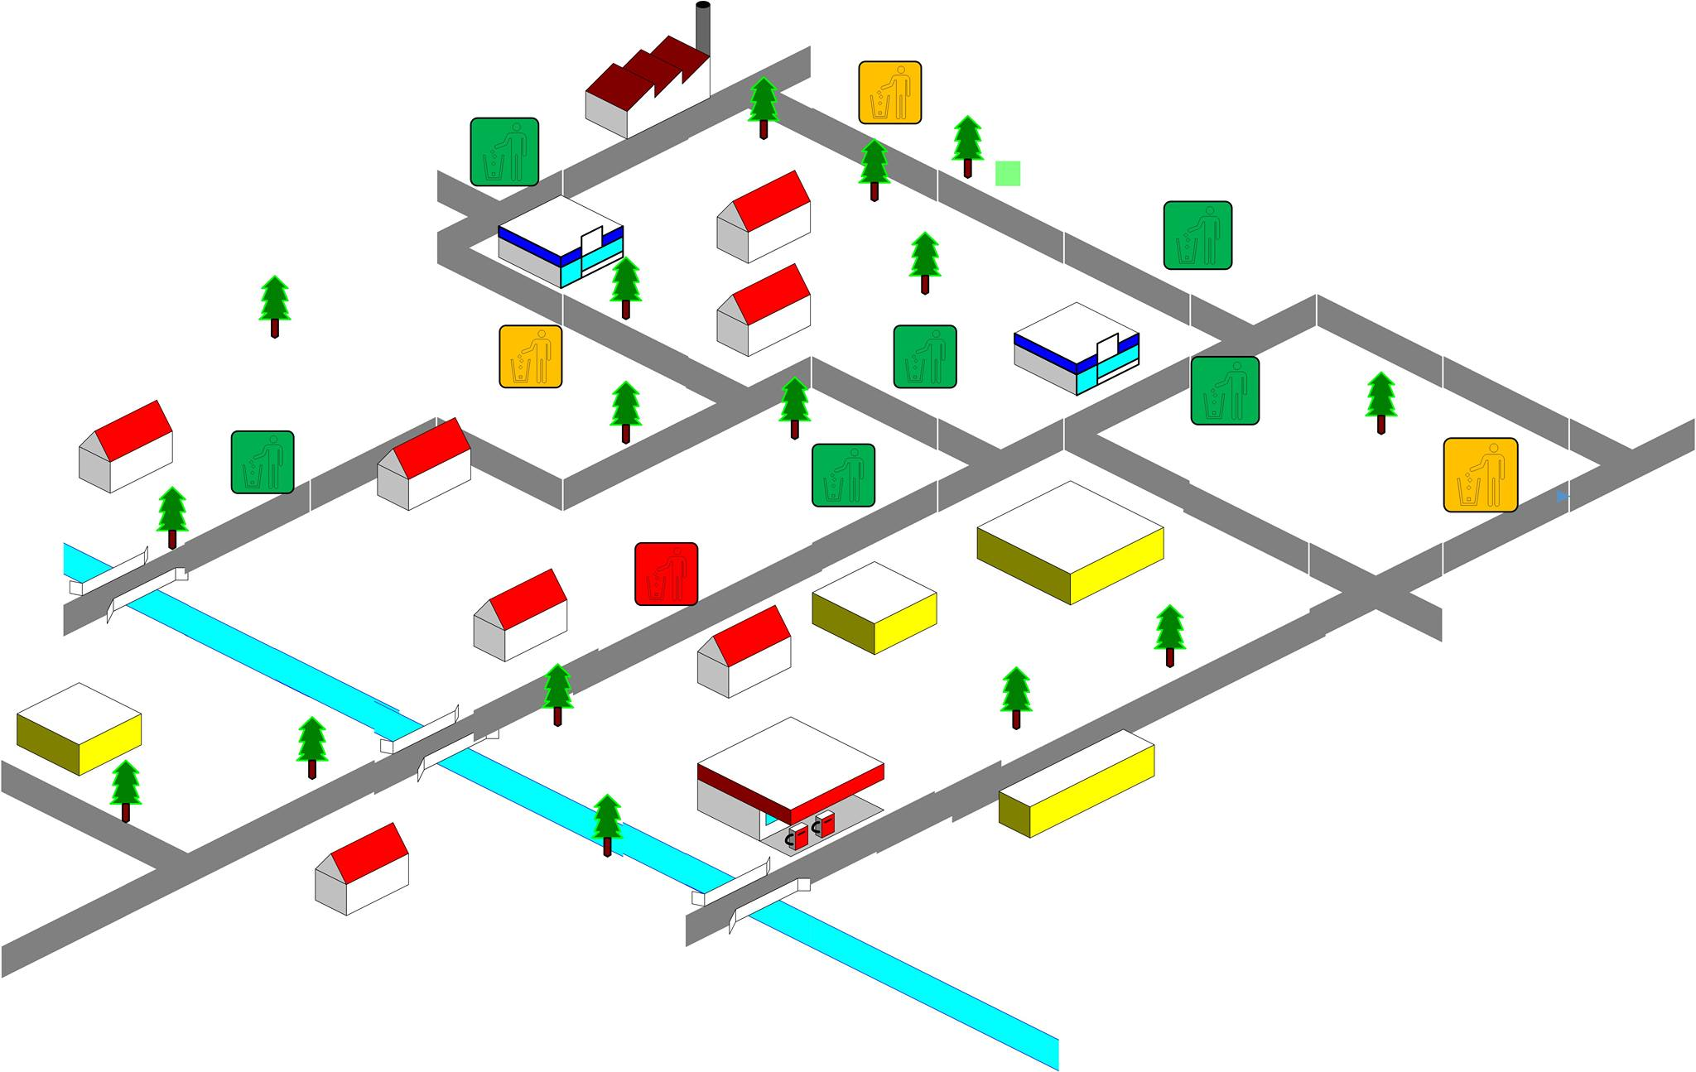


End user application con…

Slide 29

SMS Notification System
Sending SMS to cleaners and administrators, when a bin gets 80% and 100% full.
Develop a web interface to get feedback from users.
Inform system news and updates to users.
A system for users to request bins on specific locations or report malfunctions.
Ultimately provide better communication system

Slide 30
Work Allocation
Member | Main Function | Research Component
G.S.B. Dabarera | Garbage Bin Setup and Management | Build an efficient IoT module with low power consumption
R.K.R. Ranaweera | Web Services | Build an API that analyzes and utilize collected data in an optimized manner.
P.G.D.M. Perera | Workforce Application | Build an efficient route calculation algorithm.
P.A.V.D.R. Panangala | End User Application & Notification/ Feedback System | Crowdsourcing. Build an effective communication platform.

Slide 31
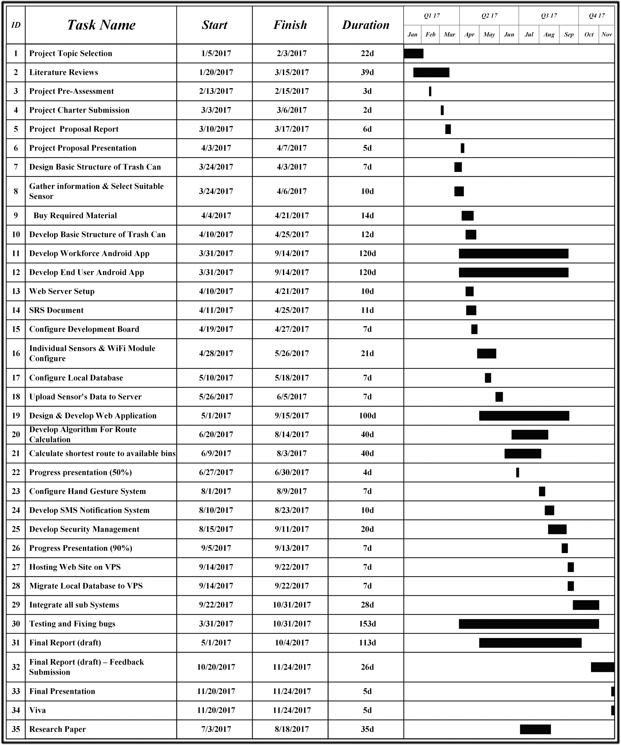
Gantt chart
*
* Indicates the current position

Slide 32
Budget
Description | No. Of Items | Cost per Item | Total
Garbage Container | 1 | Rs.2000.00 | Rs.2000.00
Raspberry pi zero | 1 | Rs.500.00 | Rs.500.00
Motion Sensor | 2 | Rs.250.00 | Rs.500.00
Infrared Sensor | 4 | Rs.180.00 | Rs.720.00
Server(VPS) | 1 | Rs.600.00 | Rs.600.00
Servo motor | 1 | Rs.350.00 | Rs.350.00
Wi-Fi Module | 1 | Rs.270.00 | Rs.270.00
Sub total |  |  | Rs.4940.00
Additional Expenses |  |  | Rs.2000.00
Grand Total |  |  | Rs.6940.00

Slide 33
Testing and Evaluvation
Building
Implementing
Testing
The proposed system has to follow a set of testing phases to check the quality of the system.
This will help to evaluate the system of various aspects:
Accuracy
Efficiency
User friendliness
During the initial stages in the testing phase each and every group member carries out an individual testing on each single task completed.
After each successful completion on the unit testing on each task, each and every component is integrated.
Then an integration testing is performed, which will ultimately eliminate the integrated errors.

Slide 34

Testing and evaluvation con….
There is a testing phase when a system is initially setup in a city
In the 1st week
bins are placed on specific locations, data is collected and analyzed
the collected data is taken as past data to calculate routes
In the 2nd week
garbage are trucks implemented with routes
Feedback system for citizens is implemented
Then the system is evaluated by the managers for the implemented city.

Slide 35
Commercialization
This project is implemented for government and private sector.
After implementing on these sectors, a value is going to be placed on the system.
This value is going to be the eventual demand for the system.

Slide 36

Thanks!
Any questions?

